Slide 1

LUMIS:
LLM BASED UNIFIED MULTIMODEL INTELLIGENT SYSTEM
Group No. 9
Dalbirsingh Matharu 21107005
Umesh Pawar 21107014
Shreyas Patil 21107061
Vedant Parulekar 21107034
Project Guide
Ms. Sarla Mary
Ms. Richa Singh

Slide 2
Contents
Abstract
Introduction
Objectives
Literature Review
Research Gap
Problem Definition
Scope
Technological Stack
Proposed System Architecture/Working
Prototype Design Demonstration
Implementation Status
Review Suggestions (Given in Last meeting)

Slide 3
Abstract
Project LUMIS is an advanced LLM-based multimodal system designed to integrate diverse capabilities into a unified platform. It offers text generation, summarization, YouTube and website transcription, image-to-text conversion, and file retrieval through APIs like OpenAI and Gemini. Powered by the LangChain framework and CrewAI, LUMIS features intelligent AI agents that learn from user interactions and automate tasks. The system includes a real-time code assistant for code comprehension, error detection, and suggestion generation, seamlessly integrating with code editors. With a focus on user-friendliness. It uses GenAI capabilities for automated SQL generation and data extraction, and leverages OpenCV with Air Canvas technology to perform real-time calculations based on finger-drawn annotations. It employes a dynamic graphical user interface, Lumis enhances efficiency and accuracy, serving as a versatile tool for developers, professionals, and content creators.
Keywords: LUMIS, LLM, API, OpenAI, Gemini, Langchain, CrewAI, Agents, GenAI, OpenCV, Air Canvas.

Slide 4
Abstract
Real time problem or challenges.
Real-Time Interactive Code Debugging: Integrating video and audio inputs to detect and resolve code errors instantly, enabling users to interactively pinpoint issues with a mouse and receive immediate, relevant solutions.
Advanced Content Processing: Combining text generation, RAG, and transcription into a single system for efficient content creation and data extraction.
Automated SQL Generation and Extraction: Implementing RAG functionality directly with MySQL to automate SQL queries and streamline data extraction for efficient schema management.
Real-Time Visual Problem-Solving: Utilizing OpenCV and Air Canvas to interpret and address user-drawn problems in real time.

Slide 5
Introduction
Real-Time Observation of the Problem Domain:
Developers today struggle with inefficient debugging due to traditional tools lacking real-time feedback and integration. Many solutions focus on separate aspects like code analysis or text generation but do not combine these functions. This results in fragmented workflows and ineffective real-time support, highlighting the need for a unified platform that integrates video, audio, and text.
Motivation:
Lumis was inspired by the limitations of existing tools that fail to offer seamless integration of video, audio, and real-time code analysis. Developers face slow error detection and inadequate feedback with current solutions. Recognizing this gap, Lumis aims to provide a comprehensive, efficient tool that enhances productivity and user experience through cohesive, advanced AI capabilities.

Slide 6
Objectives
To develop a multimodal system that detects and resolves code errors in real-time using video and audio input, with interactive error pinpointing via mouse.
To integrate advanced functionalities such as text generation, retrieval-augmented generation (RAG), and transcription into a unified platform.
To enable automated SQL generation and data extraction using GenAI, and leverage OpenCV with Air Canvas technology for real-time problem-solving based on user-drawn annotations.
To ensure seamless integration of technologies and continuous updates for maintaining advanced functionality, usability, and relevance.

Slide 7
Literature Review
Sr.no | Title | Author(s) | Year | Methodology | Drawback
1 | Retrival Augmented Genration for Knowledge Intensive NLP task | Patrick Lewis, Ethan Perez,Aleksandra Piktus, Fabio Petroni, Vladimir Karpukhin, Naman Goyal,Heinrich Kuttler,Mike Lewis, Wen tau Rocktaschel, Sebastian Riedel, Douwe Kiela | 2020 | The methodology combines seq2seq models with Dense Passage Retrieval (DPR) to enhance language generation. It uses RAG-Token for autoregressive beam search and RAG-Sequence with thorough or fast decoding for efficient text generation. | The RAG model relies heavily on external knowledge (Wikipedia), which limits scope and incurs high computational costs for retrieval. It reduces but doesn't eliminate hallucinations, lacks full interpretability, and struggles with real-time updates or multimodal inputs.
2 | LLM potentiality and awareness: a position paper from the perspective of trustworthy and responsible AI modeling | Iqbal H. Sarker | 2024 | The methodology includes defining tasks and acquiring data, selecting and fine-tuning models, and evaluating their performance with metrics. Post-evaluation, models are deployed and monitored to ensure reliability | The paper highlights LLMs' susceptibility to generating misinformation, biases, and adversarial attacks, while also being opaque in decision-making and raising privacy and ethical concerns. These issues challenge trust, fairness, and responsible deployment in AI systems.
3 | A Complete Survey on LLM-based AI Chatbots | Sumit Kumar Dam, Choong Seon Hong , Yu Qiao, Chaoning Zhang | 2024 | The paper surveys the evolution, applications, and challenges of LLM-based chatbots, from early models to current systems like ChatGPT. It aims to provide a comprehensive overview and explore future improvements for these technologies | This paper does not adequately address specific challenges faced by LLM-based chatbots, such as ethical concerns and data biases, nor does it discuss technical limitations like scalability and complex conversation handling. It lacks concrete examples or solutions related to the misuse of generated knowledge.

Slide 8
Literature Review
Sr.no | Title | Author(s) | Year | Methodology | Drawback
4 | Mini-Gemini: Mining the Potential of Multi-modality Vision Language Models | Yanwei Li1∗ Yuechen Zhang1∗ Chengyao Wang1∗ Zhisheng Zhong1 Yixin Chen1 Ruihang Chu1 Shaoteng Liu1 Jiaya Jia1, | 2024 | The methodology of Mini-Gemini focuses on improving Vision Language Models (VLMs) by enhancing visual tokens through an additional visual encoder for high-resolution refinement, constructing a high-quality dataset that supports precise image comprehension and reasoning-based generation, and leveraging VLM-guided generation techniques. | Mini-Gemini's emphasis on high-resolution visual tokens, complex architecture, and computational demands makes it overly resource-intensive and ill-suited for audio-centric projects like yours, where simpler and more focused frameworks such as Whisper and Sentence-BERT are more effective.
5 | Using an LLM to Help With Code Understanding | Daye Nam, Andrew Macvean, Vincent Hellendoorn, Bogdan Vasilescu, Brad Myers | 2024 | A user study with 32 participants compared GILT to web search, analyzing task completion and code comprehension. Quantitative and qualitative data were collected. | No significant improvement in task completion time or understanding. Benefits varied between students and professionals.
6 | Creating Large Language Model Applications Utilizing LangChain: A Primer on Developing LLM Apps Fast | Oguzhan Topsakal , and Tahir Cetin Akinci | 2023 | LangChain, a framework designed to build AI applications utilizing large language models (LLMs). It uses modular components like prompts, chains, and memory to develop customizable pipelines that interact with external data sources for tasks like question-answering and document summarization. | LangChain's reliance on LLMs means it may still face common issues like generating inaccurate outputs. Additionally, handling complex tasks can require multiple API calls, which may lead to slower execution or increased computational costs

Slide 9
Literature Review
Sr.no | Title | Author(s) | Year | Methodology | Drawback
7 | Gemini in Reasoning: Unveiling Commonsense in Multimodal Large Language Models | Yuqing Wang, Yun Zhao | 2023 | Four LLMs and two MLLMs are tested on 12 commonsense reasoning datasets using zero-shot and few-shot learning to assess accuracy, with focus on visual-textual integration | The study is limited to English datasets, missing cross-cultural nuances, and results may vary with future model updates or new datasets.
8 | Vision language models are blind | Pooyan Rahmanzadehgervi, Logan Bolton , Mohammad Reza Taesiri, Anh Totti Nguyen | 2024 | The BlindTest benchmark evaluates four top Vision Language Models (VLMs) on seven low-level visual tasks, such as counting shapes and identifying intersections, focusing on simple geometric challenges. | VLMs perform poorly on basic visual tasks, with an average accuracy of 58.57%, highlighting limitations in processing simple visual information and the inadequacy of current benchmarks in capturing these shortcomings.

Slide 10
Research Gap (Limitations of existing systems)
Survey Analysis:
No existing system integrates multimodal LLM capabilities (video/audio input, mouse-based pinpointing) for real-time error detection.
Lack of projects combining OpenCV for user-drawn problem solving or MySQL with RAG functionality.
Current AI assistants lack dynamic interaction and intelligent problem-solving in integrated environments.
Problem Status:
The problem remains unsolved; no system offers the full suite of multimodal interaction, AI assistance, and real-time code correction which LUMIS aims to deliver.
Observations and Improvement Possibilities:
Multimodal Integration: Strong potential, but integration of video, audio and user interactions can be improved.

Slide 11
Research Gap (Limitations of existing systems)
Technologies Performing Well:
OpenCV: OpenCV and Air Canvas for solving real-time, user-drawn problems on-screen.
MySQL RAG: Powerful for structured database queries and retrieval-augmented generation
Confidence in Solution:
LUMIS can bridge the gap by integrating these technologies effectively, pushing boundaries in real-time code analysis and multimodal interaction.

Slide 12
Problem Definition
Lumis addresses the challenge of real-time code error detection and resolution by integrating video, audio, and text inputs from a user's screen. It aims to provide immediate, context-aware feedback and interactive error pinpointing for developers. Additionally, Lumis seeks to unify advanced AI functionalities—such as text generation, retrieval-augmented generation (RAG), and transcription—into a single platform. The system focuses on reducing latency, enhancing precision, and offering a user-friendly interface to streamline real-time interaction and improve overall productivity

Slide 13
Scope
Integrated Error Detection: Develop a system that combines video, audio, and text inputs for instant identification and resolution of coding errors.
Interactive Debugging Tools: Create functionalities that enable users to actively pinpoint and correct errors on-screen with immediate feedback.
Unified AI Features: Merge advanced AI capabilities, including text generation, retrieval-augmented generation (RAG), and transcription, into a single, efficient platform.
Advanced User Interface and Automation: Design a dynamic, user-centric interface and automate SQL generation and data management for seamless interaction and enhanced productivity.

Slide 14
Technology Stack
Models:
Gemini 1.5 Pro
Gemini 1.5 Flash
Gemini text-embedding-004
OpenAI GPT 3.5 Turbo
OpenAI text-embedding-3-large
Libraries:
opencv-python
Pyautogui
langchain_google_genai
google-generativeai
SpeechRecognition
load_dotenv
crewai
Database:
MySQL
CassandraDB
Frontend:
Streamlit
Framework:
LangChain
CrewAI

Slide 15
Technology Stack
Models: Utilizes Gemini and OpenAI models for advanced AI capabilities, text generation, and semantic understanding.
Libraries: Incorporates OpenCV, PyAutoGUI, LangChain, and others for computer vision, automation, generative AI, and audio processing.
Database: Uses MySQL for structured data and CassandraDB for scalable data management.
Frontend: Built on Django and Django Rest Framework for web development and API creation.
Frameworks: Employs LangChain, LangSmith, and CrewAI for managing AI workflows and enhancing application intelligence.

Slide 16
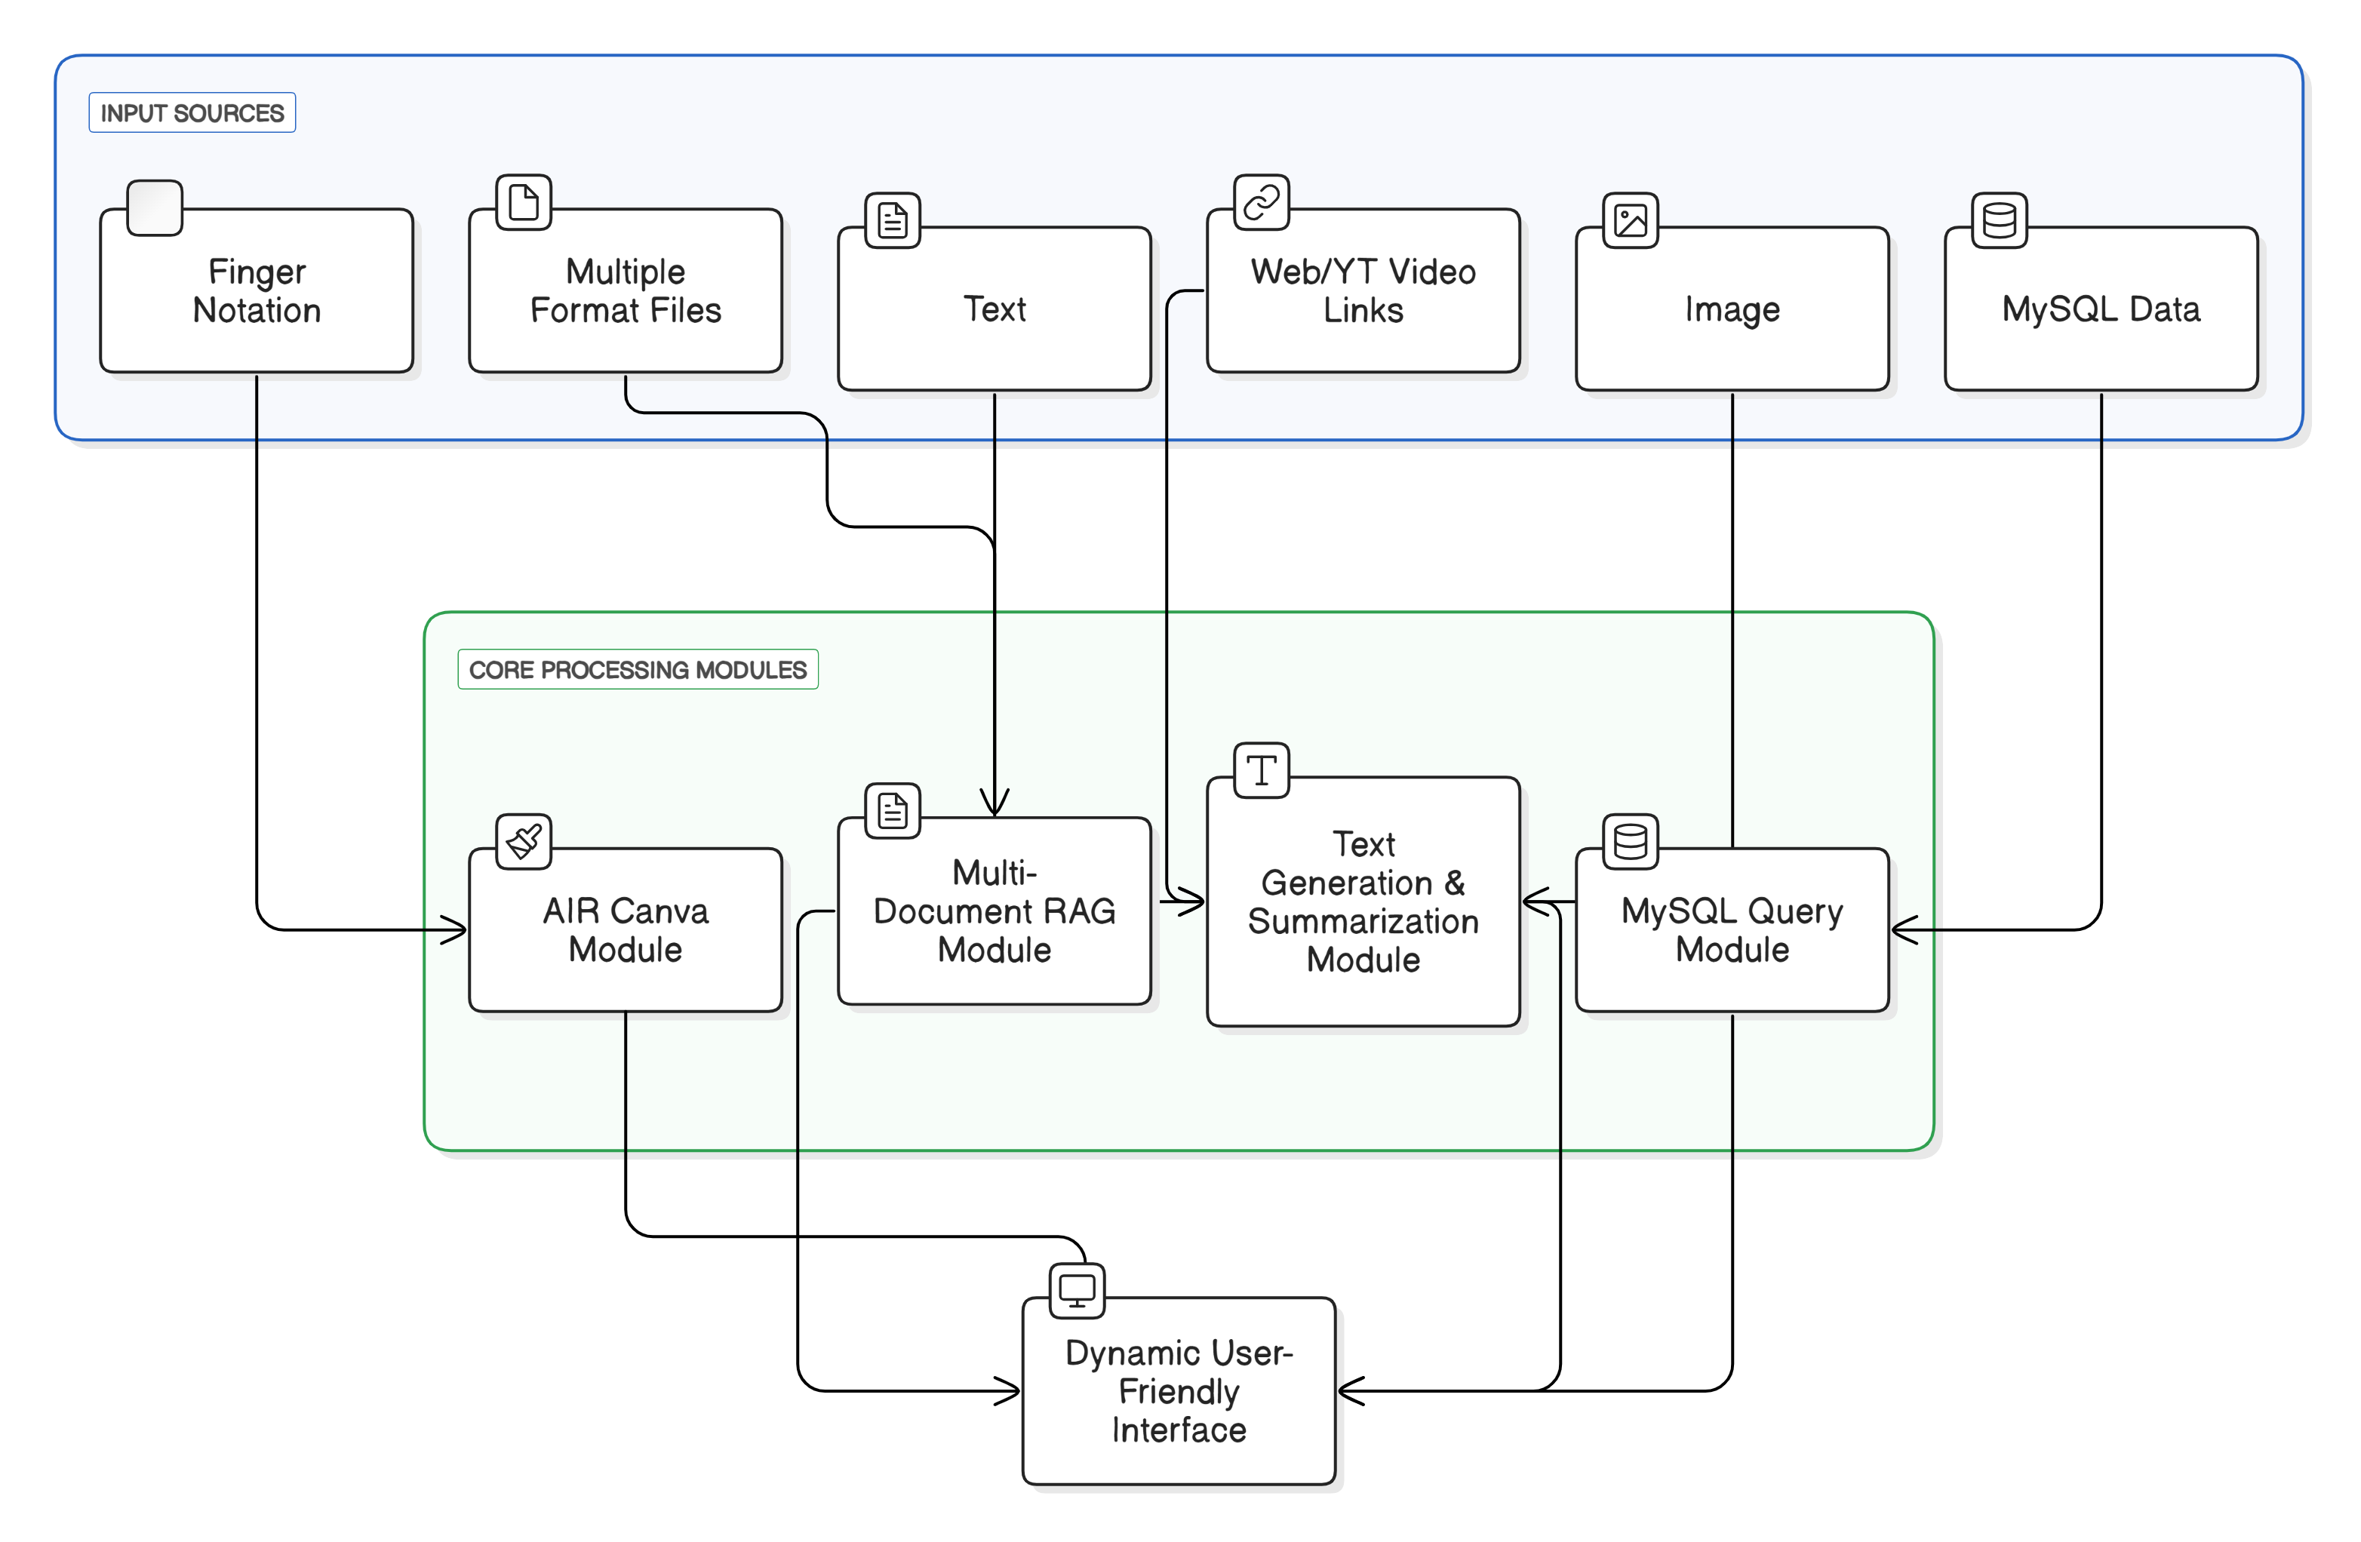

Slide 17
Proposed system architecture/Working
LUMIS Architecture
The LUMIS architecture integrates diverse input sources into specialized processing modules for effective code analysis and user interaction:
Input Sources:
Screen & Audio, Mouse Input: Connected to the Error Detection Module for real-time coding error identification.
Web/YT Video Links: Linked to the RAG & Transcription Module for information retrieval and audio transcription.
Text, Image: Directed to the Text Generation & Summarization Module and AI Agents for content generation and summarization.
MySQL Data: Connected to the MySQL Query Module for executing database queries.
Multiple Format Files: Processed by the Multi-Document RAG Module for comprehensive information retrieval.
Core Processing Modules: Each module specializes in handling its respective input for optimal results.
Dynamic User-Friendly Interface: Integrates all functionalities into a seamless interface, enhancing user experience and task management.

Slide 18
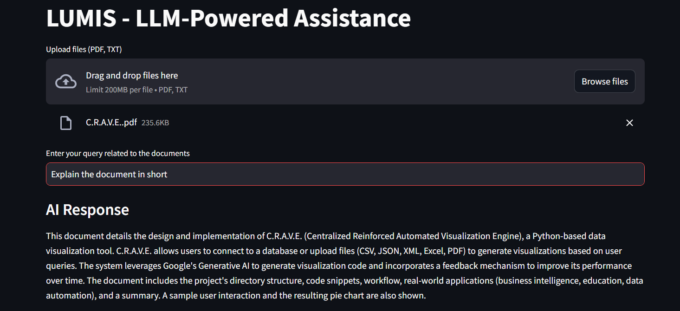
Prototype Design Demonstration

Slide 19
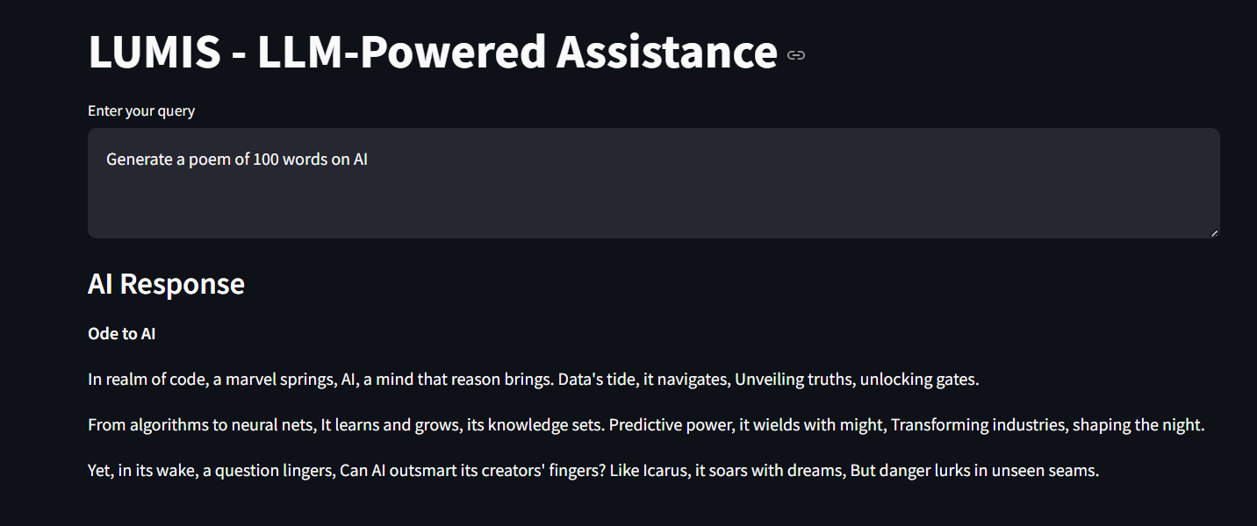
Prototype Design Demonstration

Slide 20
Implementation Status
Image to Text: Completed. Users can upload an image and query information extracted from it
YouTube Transcription: Completed. Users can input a YouTube link and receive detailed video transcription.
Multiple PDFs RAG: Completed. Retrieval-augmented generation is implemented for querying multiple PDF documents.

Slide 21
References
LangChain, https://python.langchain.com/v0.2/docs/introduction/
LangSmith, https://docs.smith.langchain.com/
OpenAI, https://platform.openai.com/docs/models
Gemini, https://ai.google.dev/gemini-api/docs/models/gemini
Gemini Vision, https://ai.google.dev/gemini-api/docs/vision?lang=python
Gemini Audio, https://ai.google.dev/gemini-api/docs/audio?lang=python
Crew AI, https://docs.crewai.com/

Slide 22
References
Pooyan Rahmanzadehgervi, Logan Bolton, Mohammad Reza Taesiri, Anh Totti Nguyen, Vision language models are blind, Auburn University, AL, USA University of Alberta, Canada, 67, 26 July 2024, https://arxiv.org/pdf/2407.06581
Sumit Kumar Dam, Choong Seon Hong, Fellow, IEEE, Yu Qiao, Student Member, IEEE, and Chaoning Zhang, A Complete Survey on LLM-based AI Chatbots,23, 17 July 2024, https://arxiv.org/abs/2406.16937
Daye Nam,Andrew Macvean, Vincent Hellendoorn, Bogdan Vasilescu, Brad Myers,Using an LLM to Help With Code Understanding,13, April 2024,https://dl.acm.org/doi/abs/10.1145/3597503.3639187
Yanwei Li, Yuechen Zhang, Chengyao Wang, Zhisheng Zhong, Yixin Chen, Ruihang Chu, Shaoteng Liu, Jiaya Jia, Mini-Gemini: Mining the Potential of Multi-modality Vision Language Models, The Chinese University of Hong Kong,19,27 March 2024, https://arxiv.org/pdf/2403.18814
Iqbal H. Sarker,LLM potentiality and awareness: a position paper from the perspective of trustworthy and responsible AI modeling,7,1 March 2024

Slide 23
References
Yuqing Wang, Yun Zhao, Gemini in Reasoning: Unveiling Commonsense in Multimodal Large Language Models, Stanford University ywang216@stanford.edu,Meta Platforms, Inc.yunzhao20@meta.com, 13,29 December 2023 , https://arxiv.org/pdf/2312.17661
Oguzhan Topsakal,T. Cetin Akinc, Creating Large Language Model Applications Utilizing LangChain: A Primer on Developing LLM Apps Fast , 8 , July 2023 https://www.researchgate.net/publication/372669736_Creating_Large_Language_Model_Applications_Utilizing_LangChain_A_Primer_on_Developing_LLM_Apps_Fast
Patrick Lewis, Ethan Perez,Aleksandra Piktus, Fabio Petroni, Vladimir Karpukhin, Naman Goyal,Heinrich Kuttler,Mike Lewis, Wen tau Rocktaschel, Sebastian Riedel, Douwe Kiela, Retrival Augmented Genration for Knowledge Intensive NLP task, 16, 2020, https://proceedings.neurips.cc/paper/2020/hash/6b493230205f780e1bc26945df7481e5-Abstract.html

Slide 24
Thank You...!!

